Slide 1

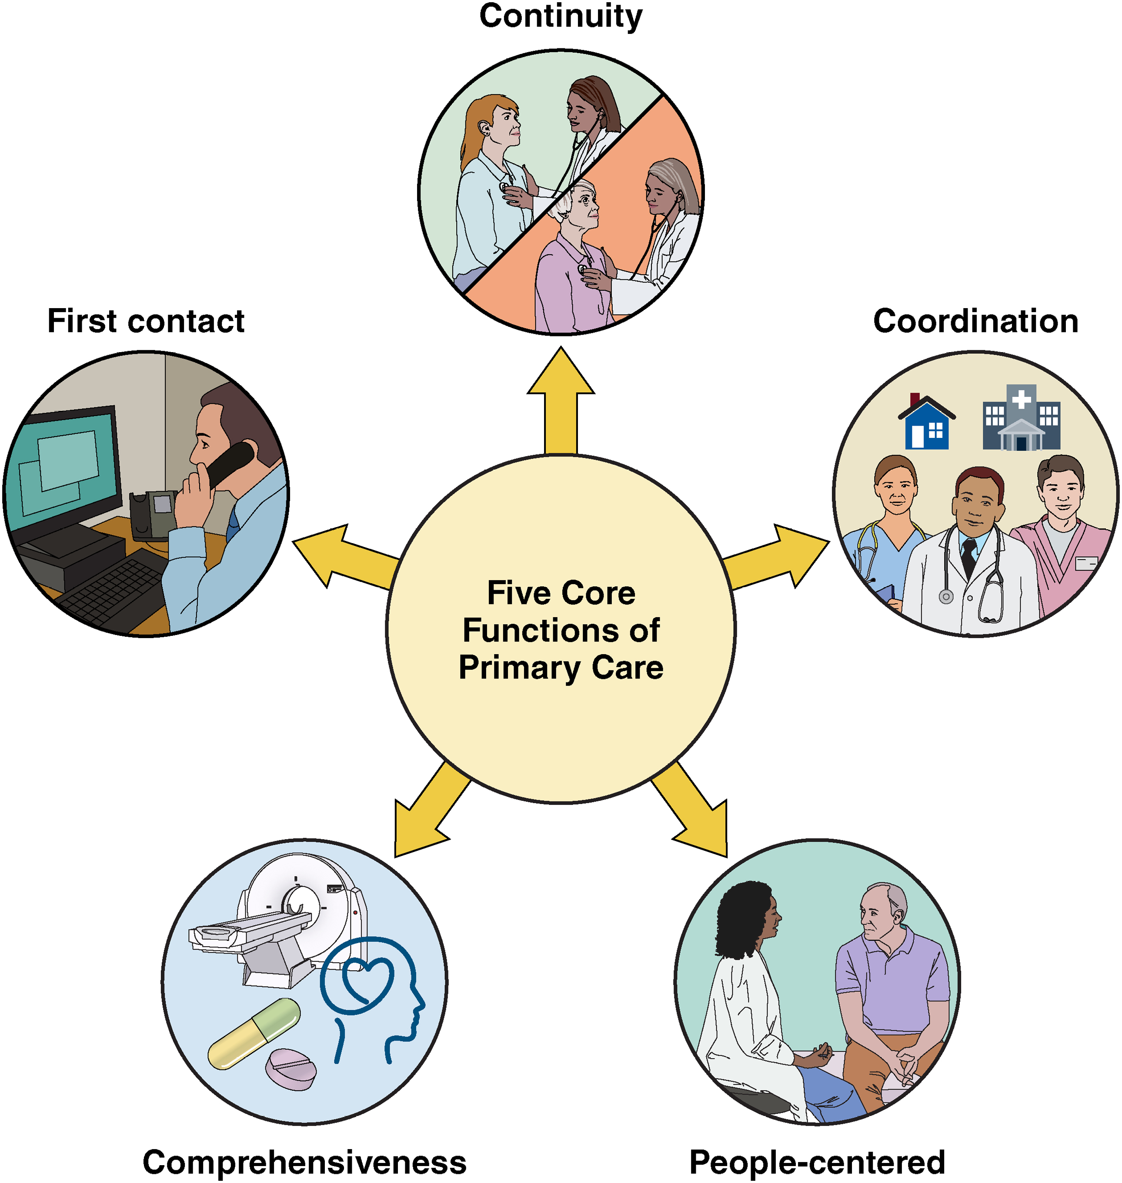
Five Core Functions of Primary care
First contact accessibility,
which creates an entry point for care and improves access to health services
Continuity
which promotes the development of long-term personal relationships between a person and the health care team
Comprehensiveness
which ensures that a diverse range of preventive, screening, diagnostic, treatment, rehabilitative, and palliative services are provided
Coordination
which posits that primary care organizes services and care across levels of the health system and over time
People-centeredness
which supports the belief and value that patients should have autonomy over their health decisions
https://www.ahajournals.org/toc/circoutcomes/17/12 - december 2024

